Slide 1
Sum of Population of US States_By_Group
File created on: 2/23/2024 2:42:12 PM

Slide 2
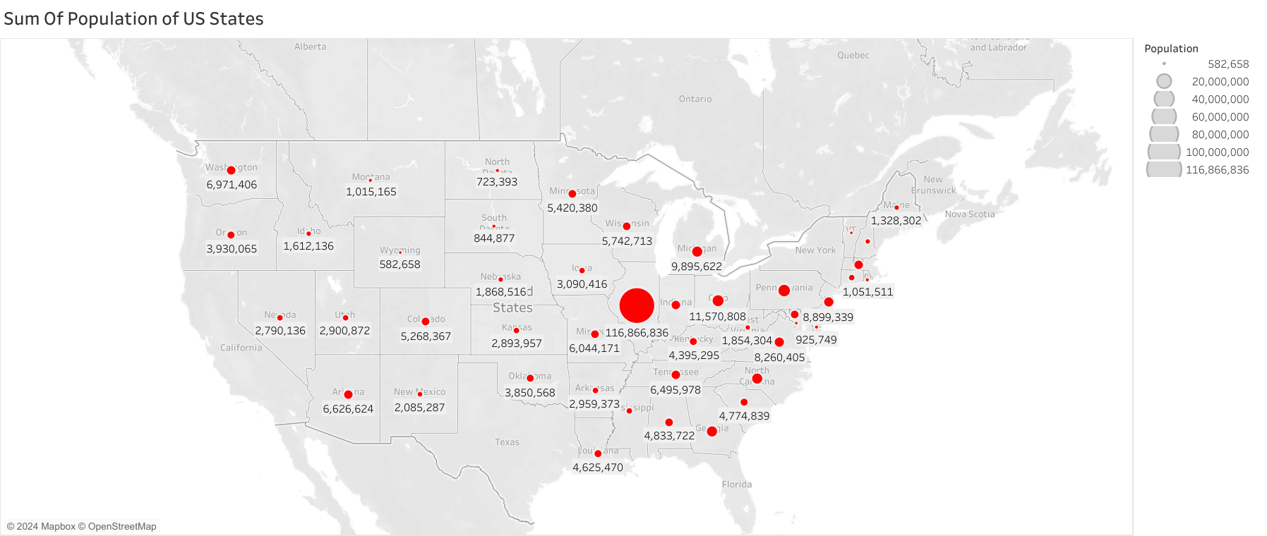

Slide 3
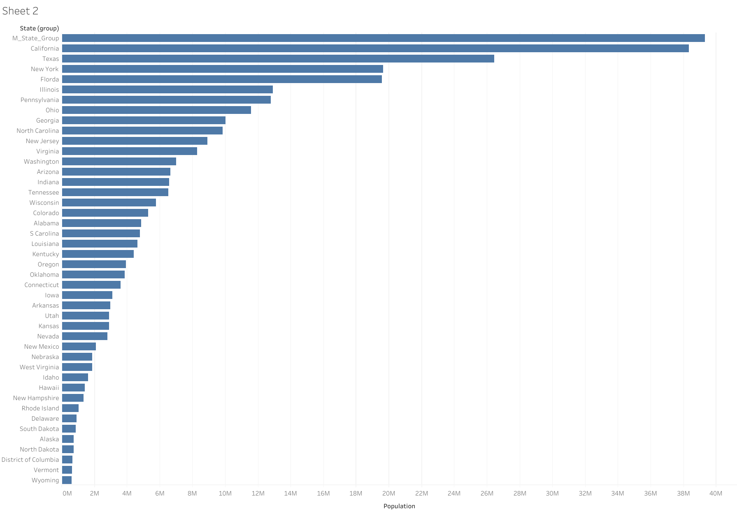

Slide 4


